Slide 1
The Ho-Kashyap Procedures
Jonathan, Nickolas, Henry, Lara
Notes:
Pg 295 in Text book, section 5.9
MSE is on pg 286 in Textbook
Henry: 5307744265
Jon - 9168966585
Lara - 9253608203
Nock - 7606083860

Slide 2
Basic Definition
The Ho-Kashyap procedure is a modification of the MSE procedure to obtain both a separating vector a and a margin vector b.
The procedure is based on modified gradient descent procedures.

Slide 3
Background: Notation
Pseudoinverse: †
Matrix of Augmented Training Samples: Y
Separating vector/ Weight Vector: a
Margin vector: b
Minimum Squared Error: MSE
Criterion Function: J_{s}(a, b)
Learning Rate: η

Slide 4
Goal and Constraint
Goal:
Given Y, determine a weight vector a and margin vector b, such that J_{s}(a, b) = ‖Ya - b‖² is zero, or determine if training samples are linearly separable
Constraints:
Training samples must be linearly separable
b > 0

Slide 5
Background: MSE Procedure
Assume b to be fixed.
Squared Error: J_{s}(a) = ‖Ya - b‖²
Gradient of Squared Error: ⛛_{a} J_{s}= 2Y^{T}‖Ya-b‖
For any b, there exists an a such that ⛛_{a} J_{s} = 0
This occurs when: a = Y†b
MSE procedure determines the vector a that minimizes the squared error for an arbitrary b

Slide 6
Background: MSE Procedure
The squared error is defined as: ‖Ya-b‖²
If the training samples are linearly separable, there exist a b for which the MSE procedure yields a correct separating vector a, however b is unknown.
There is an b, such that Ya = b
Ho-Kashyap searches for a & b to to make the squared error equal to zero
J_{s}(a,b) = ‖Ya-b‖² = 0

Slide 7
The Descent Procedure
Steps to find a and b:
Solve for gradient ⛛_{a} J_{s}= 2Y^{T}‖Ya-b‖ ⛛_{b} J_{s}= -2‖Ya-b‖
Because a = Y†b, we only need to minimize the criteria w.r.t. b at each iteration
Setting b(1)>0 ensures b(k)>0, for all k
Keep on updating b until it converges,
Updating Equation: b(k+1) = b(k) - η(k)(½)(⛛_{b} J_{s} - |⛛_{b} J_{s}|)
If the samples are linearly separable, convergence is guaranteed.
If they are not, then Ya(k)-b(k) ≠ 0 never occurs and the algorithm stops. This can be used as proof that the samples are non-separable

Slide 8
The Descent Procedure - Updating Equation
Updating Equation in Standard Descent Procedure:
b(k+1) = b(k) - η(k)(⛛_{b} J_{s})
But we introduced the constraint that b > 0
Following this updating equation could lead to converging on b = 0
Solution: refuse to reduce any components of b

Slide 9
The Descent Procedure - Updating Equation
Updating Equation in Ho-Kashyap Procedure:
b(k+1) = b(k) - η(k)(½)(⛛_{b} J_{s} - |⛛_{b} J_{s}|)
A positive gradient w.r.t. b indicates that decreasing values in b follows steepest descent, but don’t want to decrease b
Zero out any positive component of ⛛_{b} J_{s}
|⛛_{b} J_{s}| → magnitude of each individual component (not magnitude of entire vector)
(½)(⛛_{b} J_{s} - |⛛_{b} J_{s}|) → all positive components of ⛛_{b} J_{s} become zero and all negative components are unchanged

Slide 10
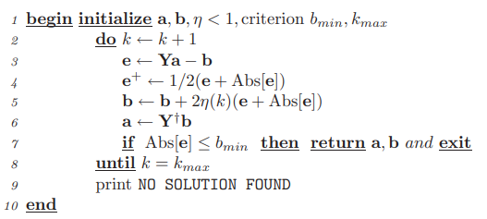
Algorithm for Ho-Kashyap

Slide 11
Matlab Code
function [a, b] = ho_kashyap(Y, k_max, eta)
% Performs the Ho-Kashyap procedure on the input training data
% y - training set matrix
% k_max - max iterations
% eta - learning rate
%
% a - weight vector
% b - bias vector
% Initialize the weight vector to 1
a = ones(size(Y,2),1);
% Initialize the bias vector to 1
b0 = ones(size(Y,1),1);
b = b0;
% Perform the Ho-Kashyap procedure
for i = 1:k_max
e = Y*a - b; % error
e_pos = 0.5 * (e + abs(e)); % positive error
b = b + 2*eta*e_pos; % update bias vector
Y_t = transpose(Y); % transpose y
Y_dagger = inv(Y_t * Y) * Y_t; % pseudoinverse y
a = Y_dagger * b; % wieght vector a
% print first iteration
if i == 1
disp("First :)")
e
a
b
end
% end if error is small
if abs(e)<=1
disp("Iterations:")
disp(i)
return
end
end
% Reached max iterations allowed
disp("No solution found :(")
end

Slide 12
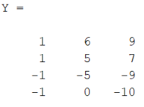
Example
Class 1: ( 6 9 ), ( 5 7 )
Class 2: ( 5 9 ), ( 0 1 0 )
Chose a and b to be initially filled with 1
Using a max iteration of 200
Using a training factor eta of 0.9

Slide 13

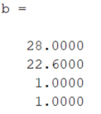
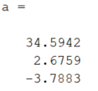
First Iteration

Slide 14
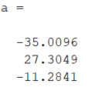
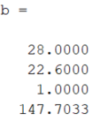
104 Iterations Later…

Slide 15
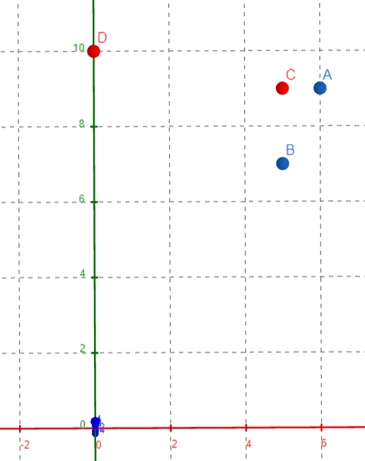
Graphical Results
Class 1: (6,9), (5,7)
Class 2: (5,9), (0,10)

Slide 16

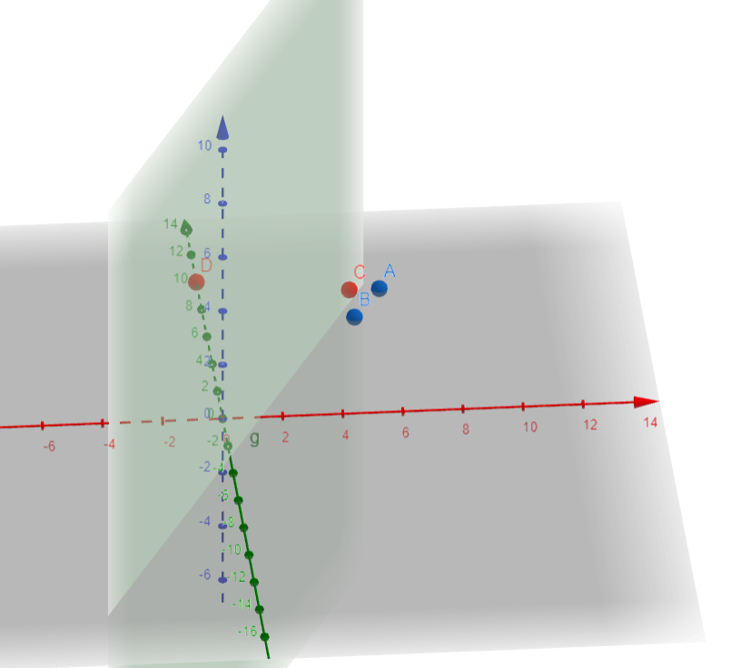
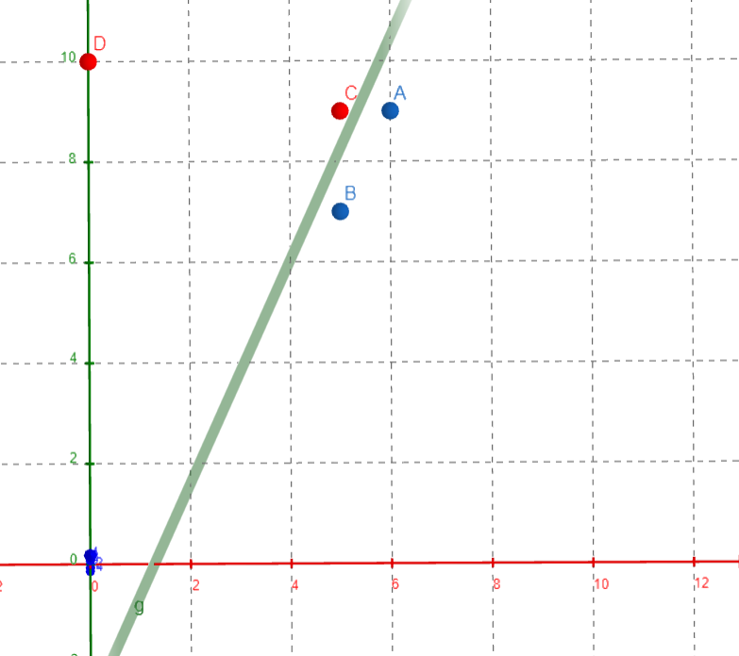
Graphical Results
g(x) = 27.3 X₁ - 11.3 X₂ - 34.9

Slide 17
Conclusion
Linear classification algorithm
Based on a quadratic cost function
Uses an iterative algorithm to update the weight vector

Slide 18
Questions?

Slide 19
References
https://cedar.buffalo.edu/~srihari/CSE555/Chap5.Part3.pdf
https://www.csd.uwo.ca/~oveksler/Courses/CS434a_541a/Lecture10.pdf
Example
https://www.youtube.com/watch?v=sKuHAkkvQqU&t=1341s

